Slide 1


Slide 2

What is Microsoft Excel?
Excel Overview
Microsoft Excel is a spreadsheet application used to work with data.
It allows users to:
Enter and organize information
Perform calculations
Manage records
Analyze data
Create charts
Prepare reports
In Simple Words
Excel helps us organize data and turn it into useful information.

Slide 3
Excel Step
Basic Excel
Intermediate Excel
Advanced
Excel

Slide 4

Where Do We Use Excel?
Excel in Real Life
Excel is used in many daily and professional activities.
Examples
Student marksheets
Monthly budgets
Sales reports
Attendance records
Employee details
Business reports
Expense tracking
Inventory records
Simple Example
Raw Sales Data → Excel Analysis → Business Report

Slide 5

Why Learn Excel?
Why is Excel an Important Skill?
Excel is important because data is everywhere.
Students and professionals need to:
Understand numbers
Manage information
Analyze performance
Create reports
Support decisions
Key Message
Excel is a practical skill that is useful in both education and professional life.

Slide 6

Excel Generations
The Evolution of Excel
Excel has changed from a simple calculation tool into a powerful data tool.
Generation 1 – Spreadsheet Era
Basic tables and calculations.
Generation 2 – Office Productivity Era
Formatting, charts, and business reports.
Generation 3 – Data Analysis Era
Advanced formulas and PivotTables.
Generation 4 – Automation Era
Power Query and advanced data tools.
Generation 5 – Modern Excel Era
Cloud collaboration, dynamic functions, and AI-supported features.
Slide 6 – Excel Timeline
Today
Excel supports modern analysis, collaboration, automation, and AI-powered productivity.

Slide 7
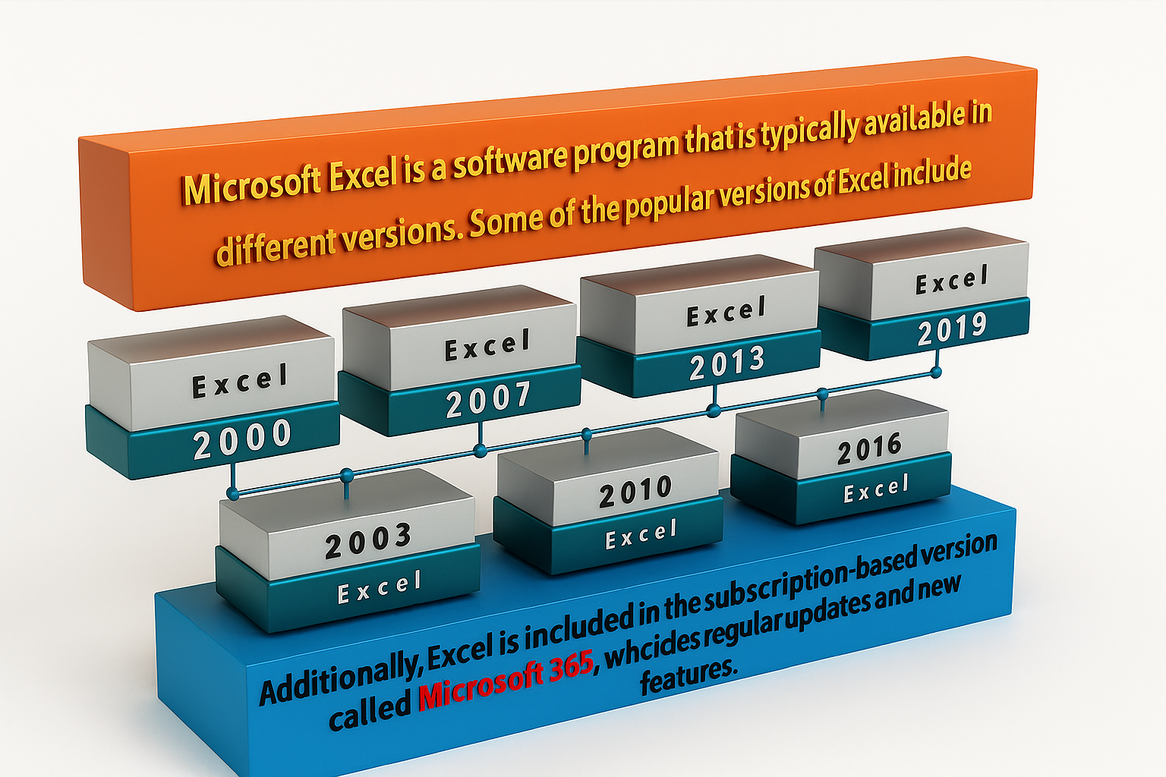

Slide 8

EXCEL BASICS
Slide 7 – Understanding the Excel Workspace
Main Parts of Excel
Workbook
Worksheet
Rows
Columns
Cells
Cell Address
Ribbon
Formula Bar
Name Box
Sheet Tabs
Example
Cell B5
B = Column
5 = Row

Slide 9

Basic Excel Skills
Basic Level Skills
At the beginner level, students learn how to work confidently with spreadsheets.
Main Skills
Data entry
Editing data
Cell formatting
Working with rows and columns
Creating worksheets
Copy and paste
AutoFill
Find and Replace
Sorting
Filtering
Printing

Slide 10
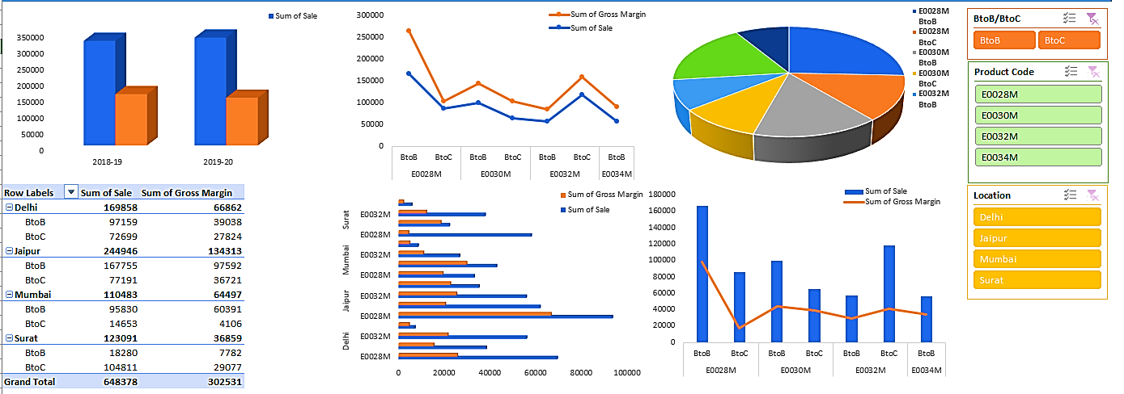
EXCEL DASHBOARD EXAMPLE
D:\Dashboard.xlsx

Slide 11

From Raw Data to Dashboard
The Excel Analysis Process
Step 1
Collect Data
↓
Step 2
Clean Data
↓
Step 3
Analyze Data
↓
Step 4
Create Summary
↓
Step 5
Build Charts
↓
Step 6
Create Dashboard

Slide 12
What Can You Create with Excel?
Excel Output Examples
Using Excel, you can create:
Sales reports
Student performance reports
Budget reports
Inventory reports
HR reports
Financial reports
KPI reports
Interactive dashboards
Key Point
Excel helps transform data into reports that are easier to understand.

Slide 13

Benefits of Learning Excel
How Excel Helps You
1. Saves Time
Quick calculations and reports.
2. Improves Accuracy
Reduces manual calculation work.
3. Organizes Information
Keeps data in a structured format.
4. Supports Analysis
Helps identify patterns and trends.
5. Improves Productivity
Allows users to complete tasks efficiently.
6. Builds Professional Confidence
Makes students more prepared for workplace tasks.

Slide 14
Excel for BBA Students
Excel in Business Management
BBA students can use Excel for:
Sales tracking
Marketing analysis
Budget planning
Customer data
Business reports
Basic business dashboards
Focus
Business operations and reporting

Slide 15

Excel for BCA Students
BCA students can use Excel for:
Data preparation
Data analysis
Project data
Database exports
Data cleaning
Technical reporting
Focus
Data and technology support

Slide 16

Excel in Management and Decision-Making
MBA students can use Excel for:
Business analysis
Financial planning
Performance measurement
Forecasting
KPI analysis
Management reports
Focus
Analysis and business decision-making

Slide 17
Excel Learning Roadmap
From Beginner to Professional
Stage 1 – Basic Excel
Data Entry + Formatting + Basic Formulas
Stage 2 – Intermediate Excel
Logical Functions + Lookup + PivotTables
Stage 3 – Advanced Excel
Complex Formulas + Dynamic Functions
Stage 4 – Data Preparation
Power Query + Data Cleaning
Stage 5 – Reporting
Charts + Dashboards + KPIs
Stage 6 – Next-Level Skills
SQL + Power BI + Data Analytics

Slide 18
Career Opportunities
Jobs Where Excel Skills Are Valuable
MIS Executive
Data Analyst
Business Analyst
Operations Executive
Financial Analyst
Accounts Executive
HR Analyst
Sales Analyst
Reporting Executive
Project Coordinator
Important
Different jobs require different levels of Excel skills.

Slide 19
Industries That Use Excel
Excel Demand Across Sectors
Banking and Finance
Financial records and analysis.
IT and Technology
Data management and reporting.
Retail and E-Commerce
Sales and customer analysis.
Healthcare
Operational records and reports.
Manufacturing
Production and inventory tracking.
Human Resources
Employee information and reporting.
Education
Student records and performance reports.
Government and NGOs
MIS, surveys, and reporting.

Slide 20
Your Excel Career Path
What Should You Learn Next?
For Business Students
Excel → Business Analysis → Power BI
For Technology Students
Excel → SQL → Data Analysis → Python
For Finance Students
Excel → Financial Analysis → Advanced Reporting
For Management Students
Excel → Dashboards → Business Intelligence

Slide 21
Conclusion
Excel is a Starting Point for Bigger Opportunities
Excel helps you develop the ability to:
Work with data
Solve business problems
Create useful reports
Analyze information
Prepare for professional roles
Final Message
Start with Excel. Build your skills. Grow your career.

Slide 22

Q&A
Open the floor for any questions from the audience.

Slide 23


FOR YOUR ATTENTIONS

